Slide 1
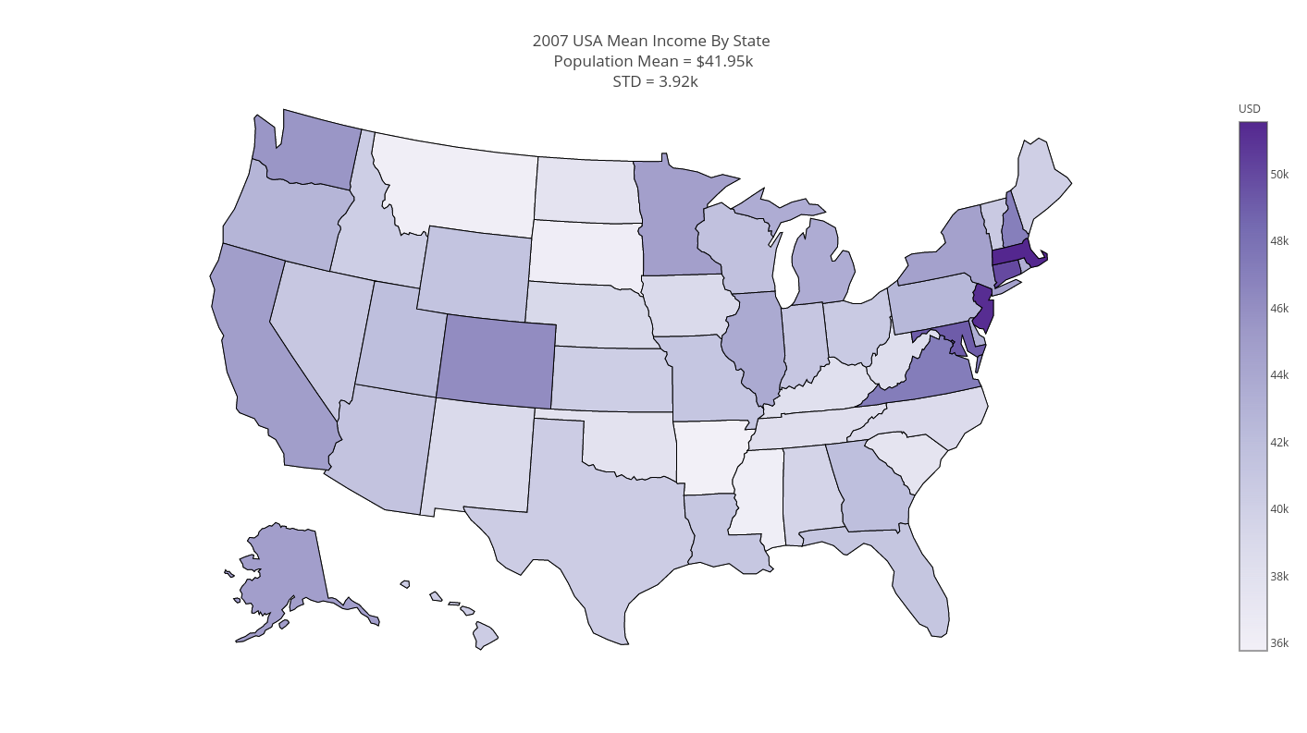
Predicting Lower Income Clients Based on the 2007 United States Department of Commerce Current Population Survey

Slide 2




Project Goals
Statistical analysis of the 2007 United States Department of Commerce Current Population Survey
Identifying importance features which impact salary (for example: Occupation, age, gender etc.)
Creating a classifier which to identify individuals which earns less then $40K per year

Slide 3
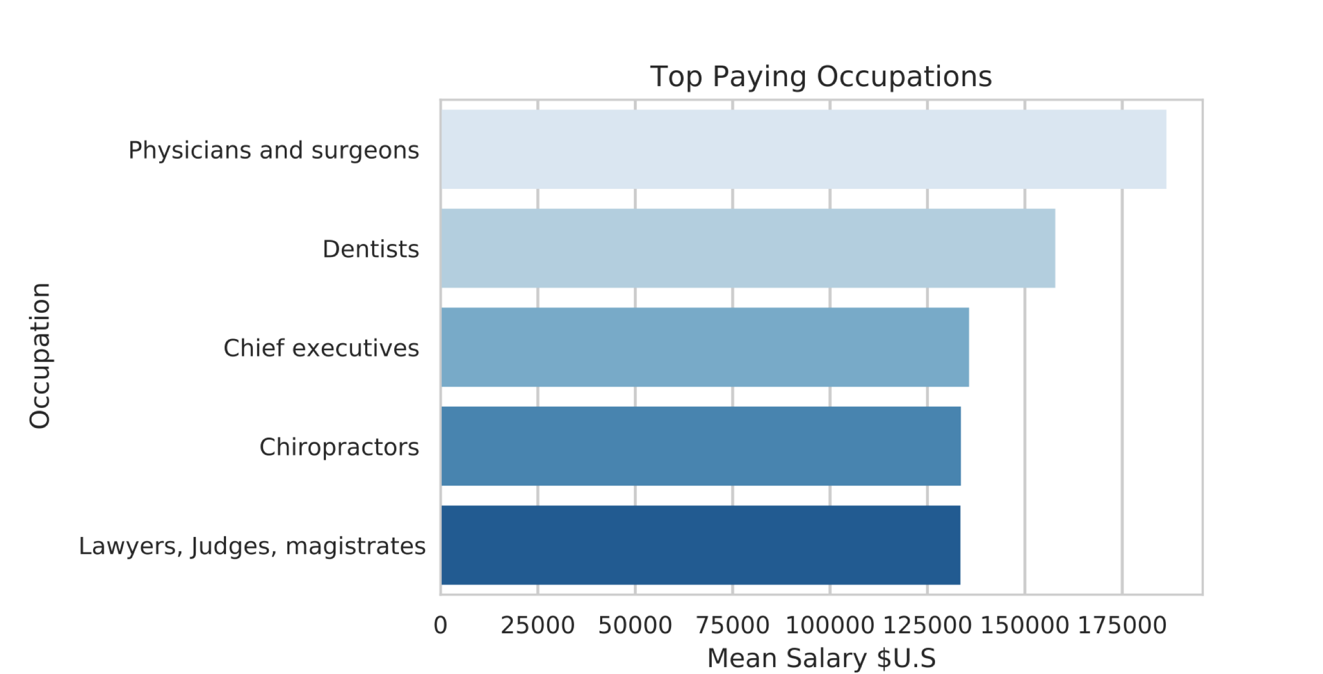

What affects our salary?
Occupation

Slide 4
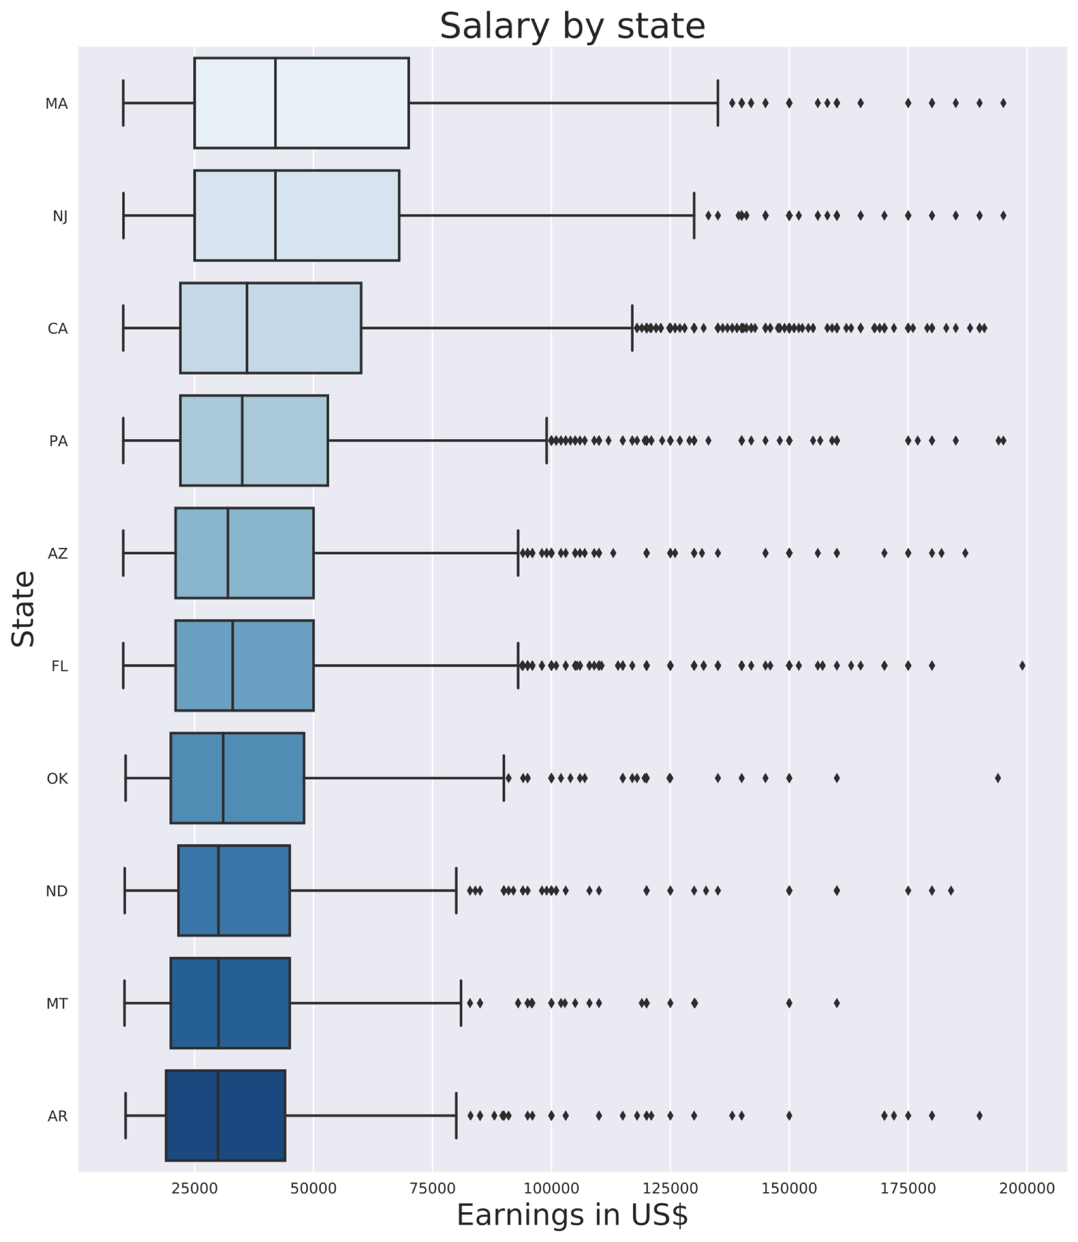
What affects our salary?
State
Different states have different mean earnings
There is also a difference in the outliers distribution
Statistically significant difference in the mean between states.

Slide 6
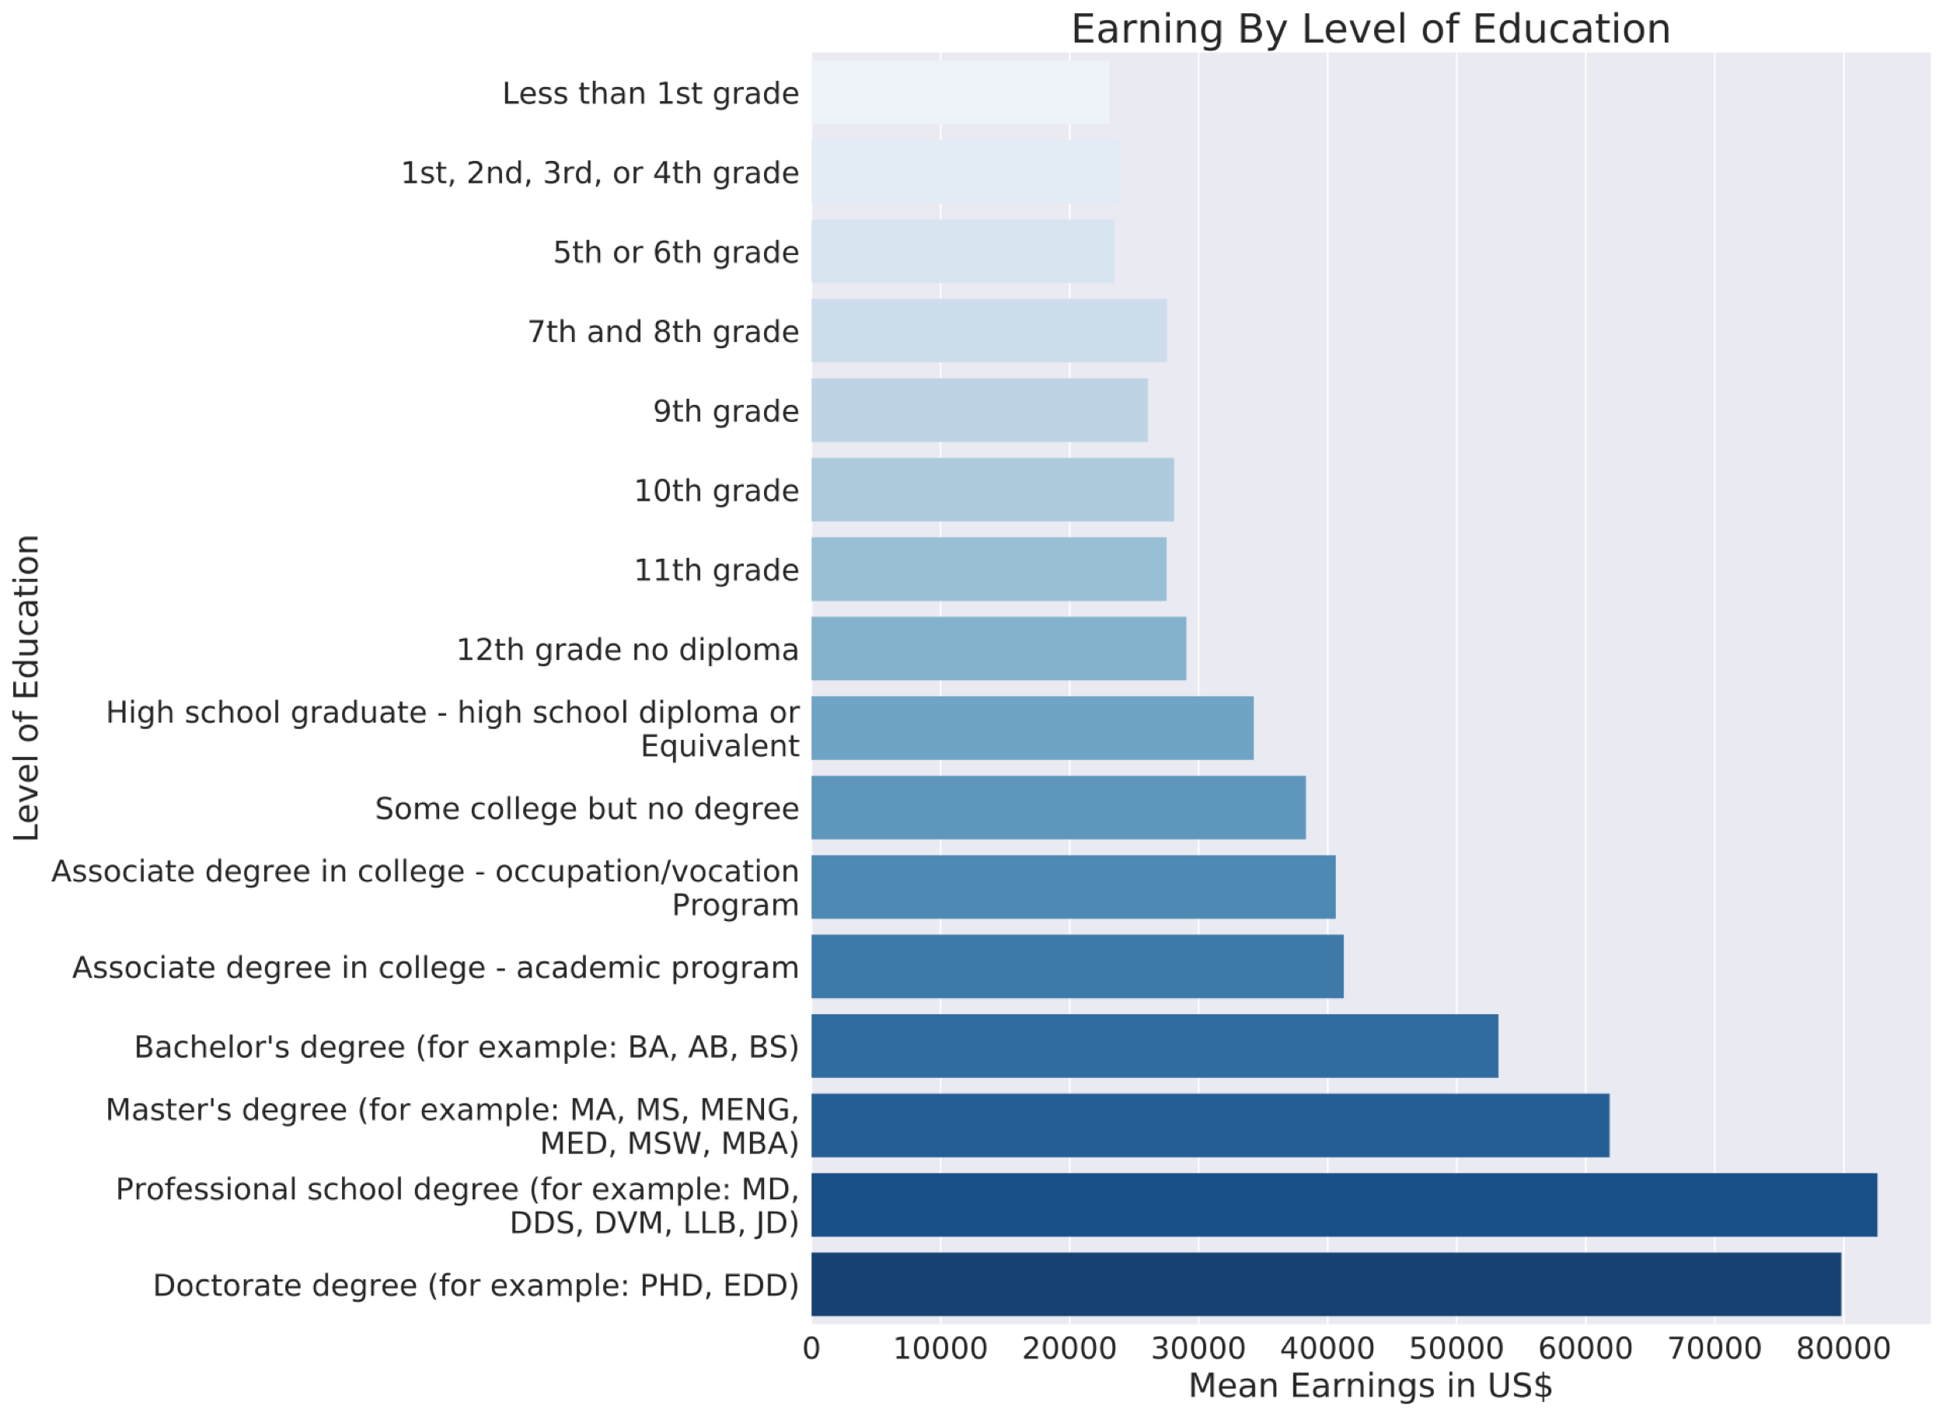
What affects our salary?
Education
Education level is correlated with mean income.
There are distinct jumps for high-school graduates, college graduates and post-graduates
Statistically significant difference in the mean college graduates and non graduates.

Slide 7
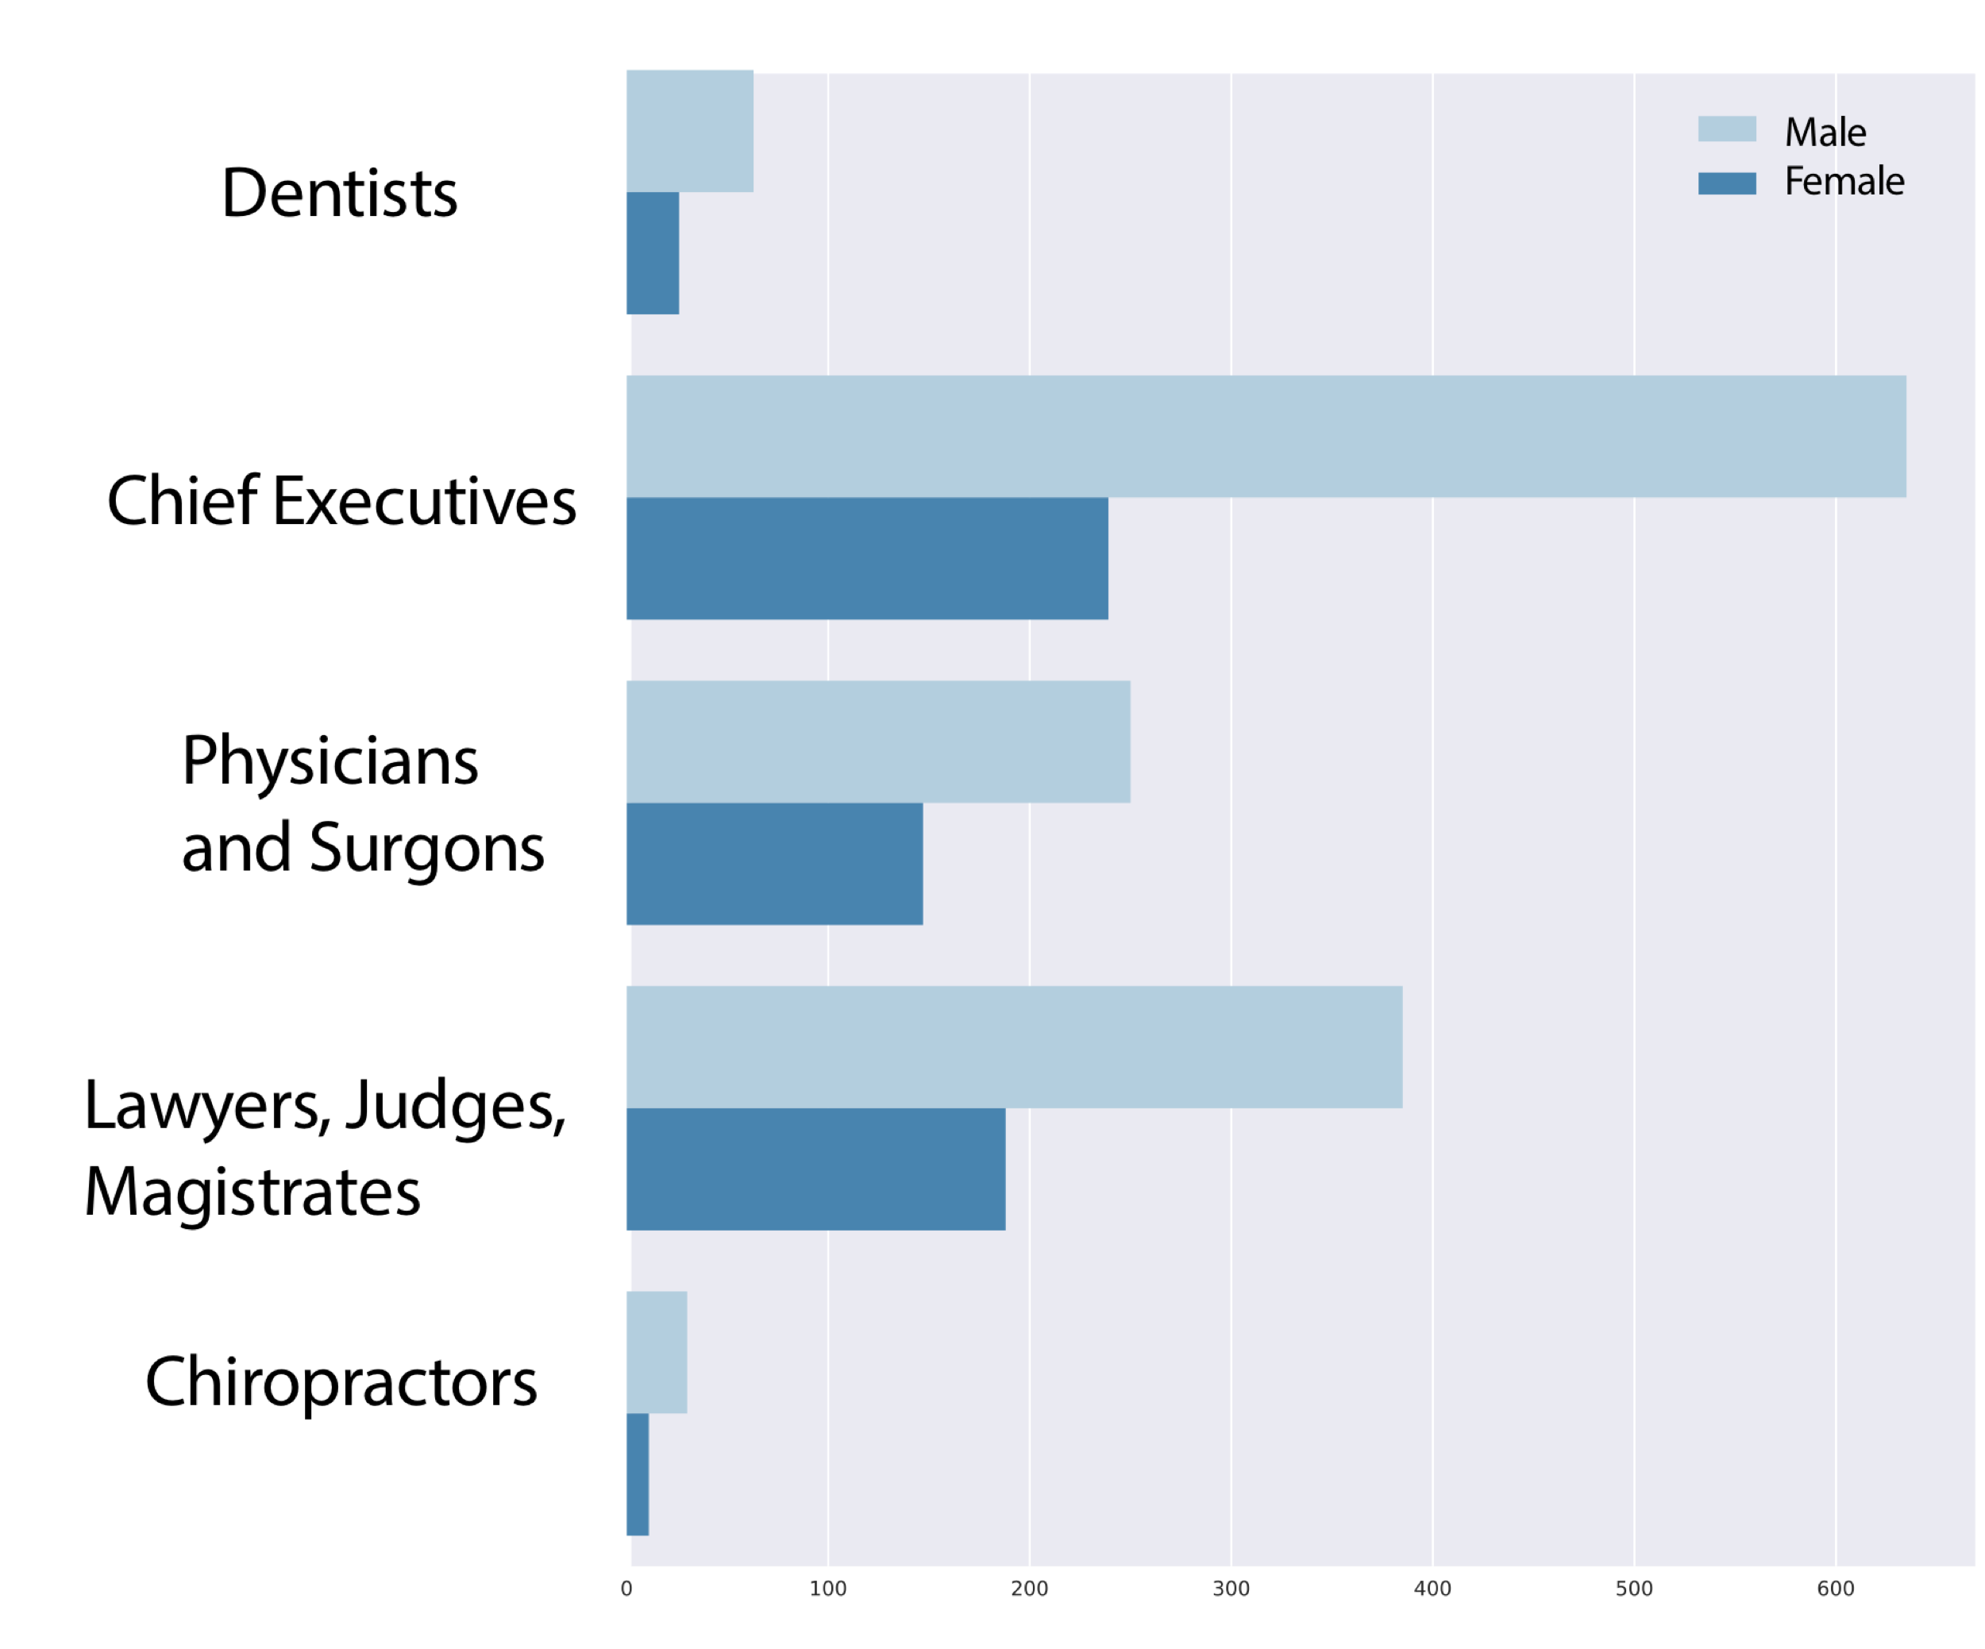
What affects our salary?
Gender
Women are under represented in high paying occupations
There is also a difference in pay scale within the same occupation (not general for all occupations)
Women tends to earn less then their spouses within the same household

Slide 8
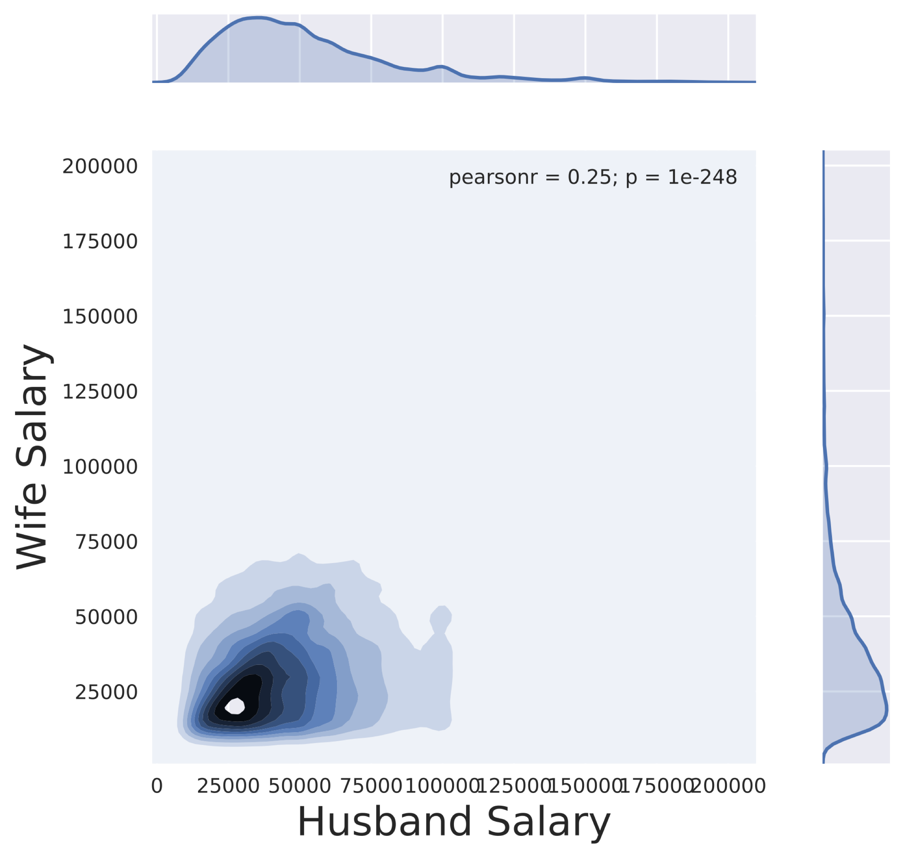
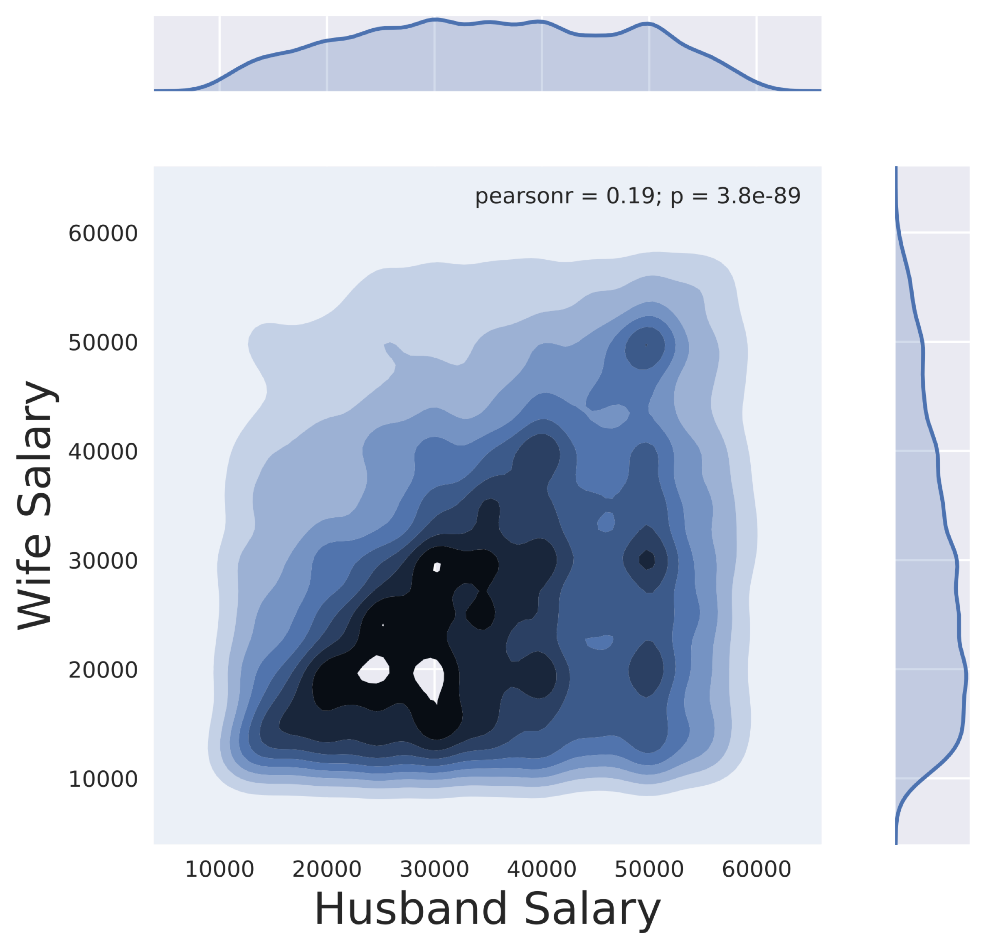
What affects our salary?
Household correlations

Slide 9
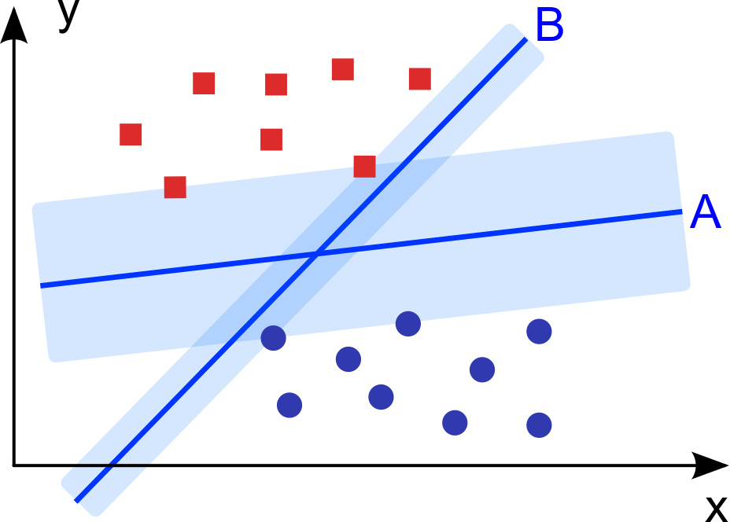
Classification
Comparing classifiers
Classifier | Accuracy | Cohen’s Kappa | F1-Score
Logistic Regression | 0.78 | 0.55 | 0.722
SVM | 0.8 | 0.55 | 0.719
Random Forest | 0.81 | 0.56 | 0.71
Gradient-Boosting | 0.81 | 0.55 | 0.719
XGBoost | 0.81 | 0.58 | 0.724
lightGBM | 0.81 | 0.56 | 0.74
Logistic regression is fast and give good f-1 score
SVM is has higher accuracy but worse f-1 score (“accuracy paradox”)
For random forest we get better kappa score, but worse f-1 score, better true negative detection
Gradient boosting performs really well. XGBoost is best but LightGBM gives similar prediction levels and is much faster

Slide 10
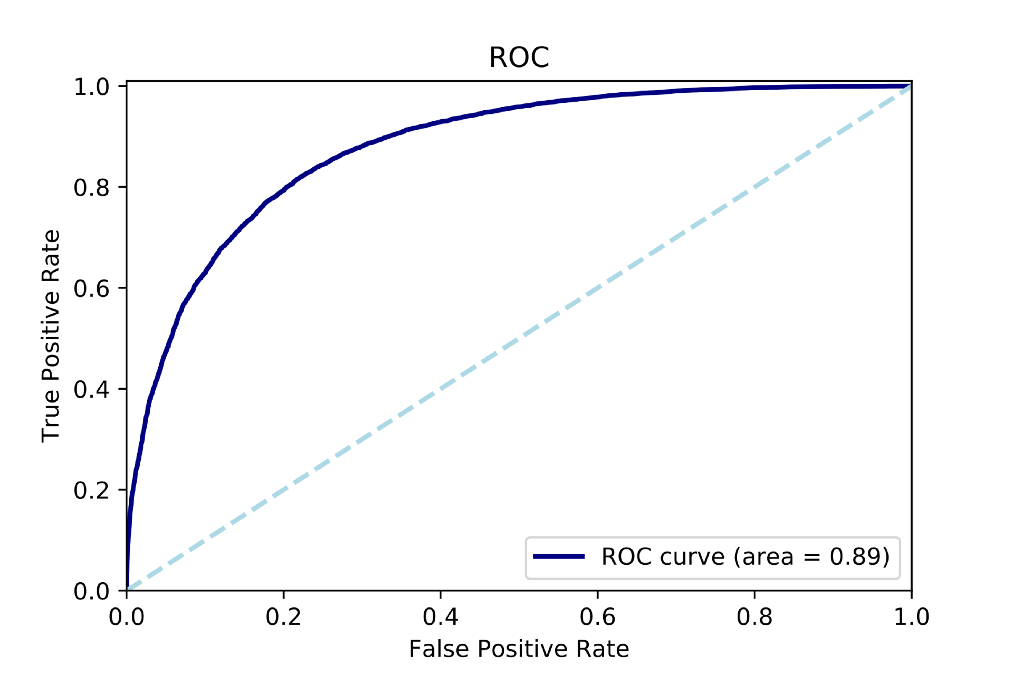
Classification
ROC curve and AUC
ROC curve for LightGBM
The AUC is 0.89
The threshold should be tuned according to the importance of the true positive rate

Slide 11
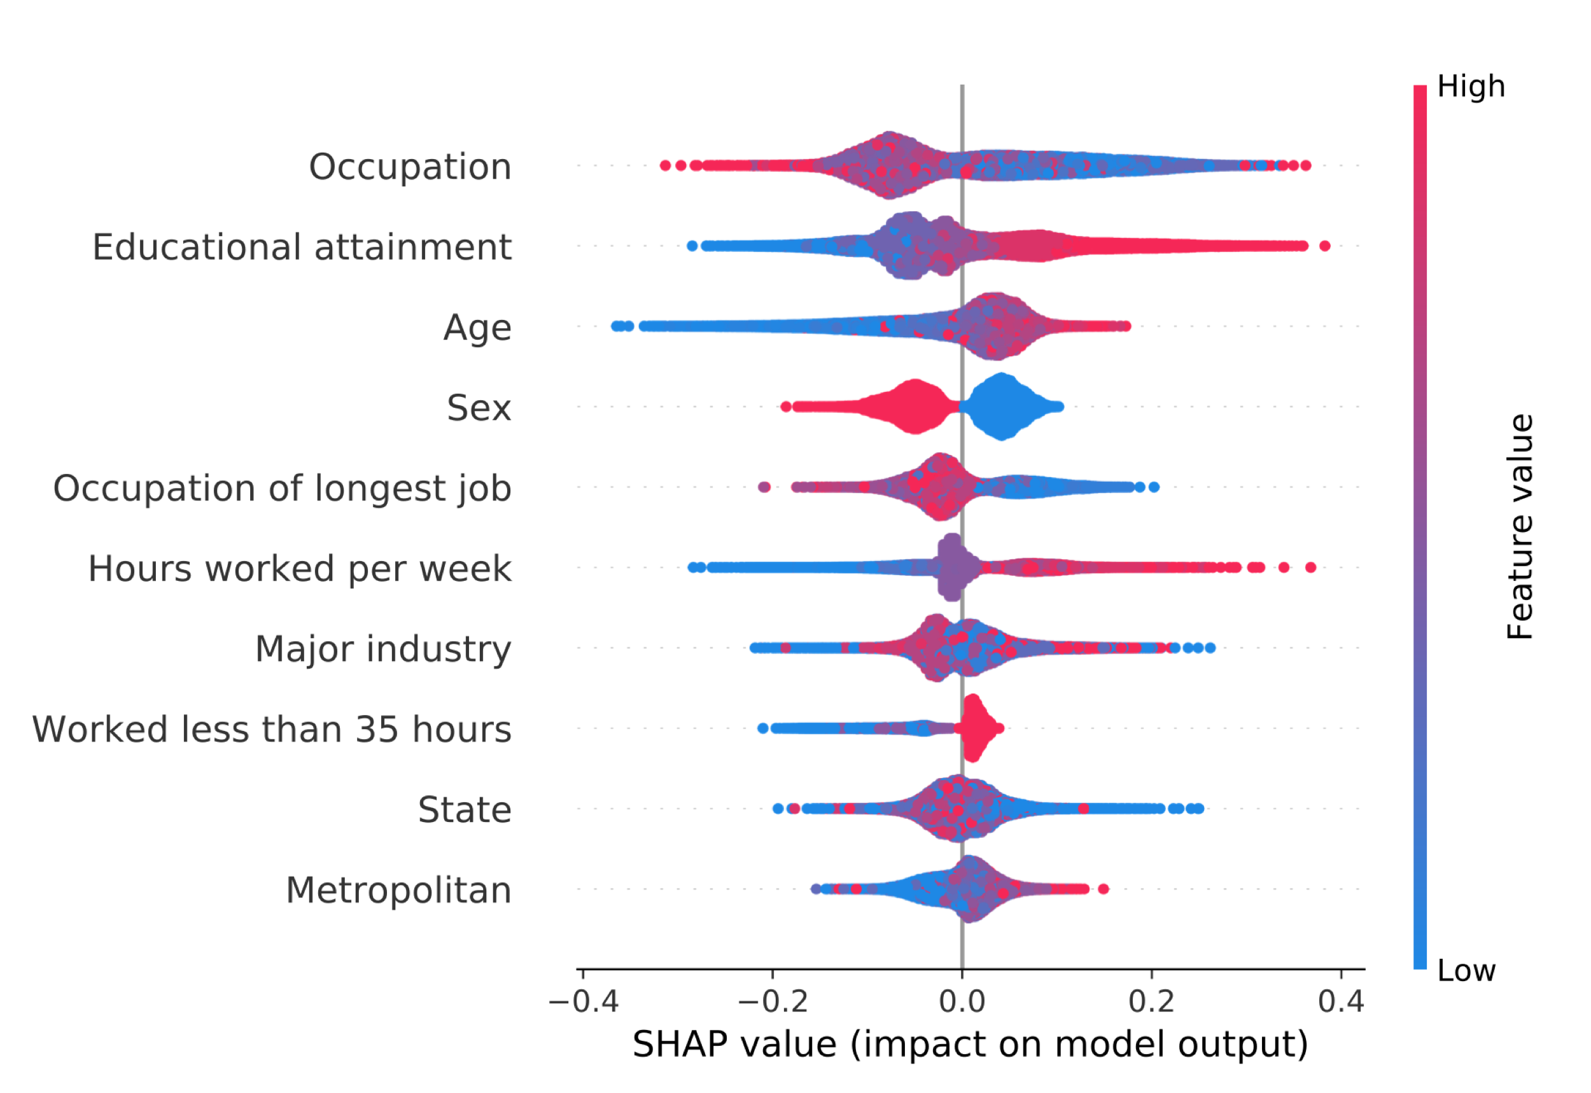
Classification
Feature importance

Slide 12
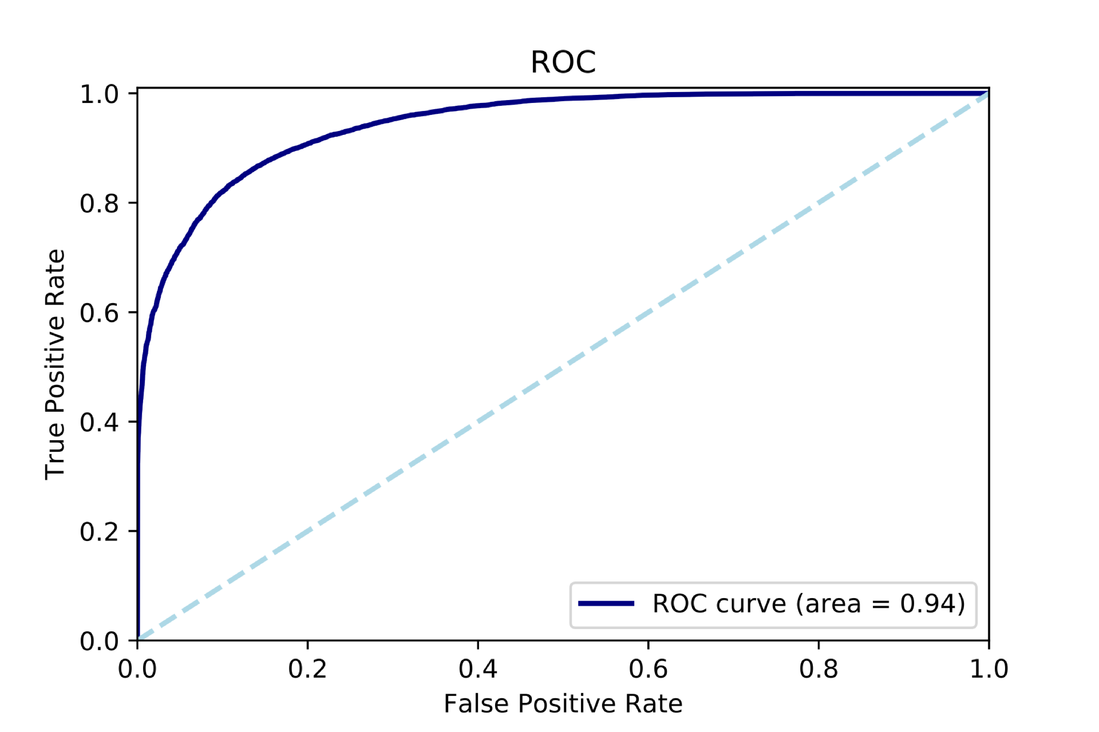
Classification
Predicting gender
The classifier can be used to accurately predict gender
f-1 : 0.85
Cohen’s kappa : 0.72
Accuracy : 0.86
Discriminative job market

Slide 13
Suggestions for future improvements
Some of the occupations are underrepresented. Getting a more accurate distribution of salary for each occupation should improve the score.
Grouping together similar occupations (or occupations with similar wage distribution)
Sample microdata for the US Census are readily available online and contains millions of records
Scarping Glassdor™ for income distributions
Multi-Class classification methods

